Slide 1

Data Modeling and Simulation
Dr. Fadi M. S. Alsuhimat

Slide 2
Recap: Performance Evaluation
Performance Evaluation
Performance Measurement
Performance Modeling
Analytic Modeling
Simulation

Slide 3
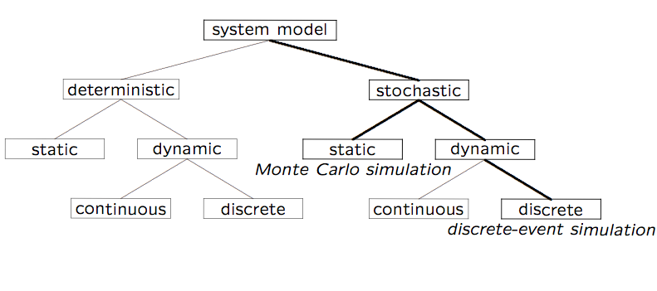
Simulation Model Taxonomy (preview)

Slide 4
Terminology (1 of 2)
A system is defined as a group of objects that interact with each other to accomplish some purpose
  A computer system: CPU, memory, disk, bus, NIC
  An automobile factory: Machines, components parts and workers operate jointly along assembly line
A system is often affected by changes occurring outside the system: system environment
  Hair salon: arrival of customers
  Warehouse: arrival of shipments, fulfilling of orders
    Effect of supply on demand: relationship between factory output from supplier and consumption by customers

Slide 5
Terminology (2 of 2)
Entity
  An object of interest in the system: Machines in factory
Attribute
  The property of an entity: speed, capacity, failure rate
State
  A collection of variables that describe the system in any time: status of machine (busy, idle, down,…)
Event
  An instantaneous occurrence that might change the state of the system: breakdown

Slide 6
Simulation Modeling
Develop a simulation program that implements a computational model of the system of interest
Run the simulation program and use the data collected to estimate the performance measures of interest (often involves the use of randomization)
A system can be studied at an arbitrary level of detail
Quote of the day:
“The hardest part about simulation is deciding what NOT to model.” - Moe Lavigne, Stentor, Summer 1995

Slide 7
Advantages of Simulation
New policies and procedures can be explored without disrupting the ongoing operation of the real system
New designs can be tested without committing resources for their acquisition
Time can be compressed or expanded to allow for a speed-up or slow-down of the phenomenon under study
Insight can be obtained about the interactions of variables, and which ones have the most impact on system performance
Can obtain answers to “What if…” questions

Slide 8
Disadvantages of Simulation
Model building requires special training
  An important role for courses like CPSC 531!!
  Vendors of simulation software have been actively developing packages that contain models that only need input (templates), which simplifies things for users
Simulation results can be difficult to interpret
  Need proper statistical interpretation for output analysis
Simulation modeling and analysis can be time- consuming and expensive, both for the modeler, as well as in compute time (if not done judiciously)

Slide 9
When Simulation Is Not Appropriate
When the problem can be solved by common sense
When the problem can be solved analytically
When it is easier to perform direct experiments
When cost of simulations exceeds (expected) savings for the real system
When system behavior is too complex (e.g., humans)

Slide 10
Common Mistakes in Simulation
Poor (pseudo) random number generators
  Best to use well-known or well-understood generator
Improper selection of seeds for PRNG
  Short periods; same seeds for all streams
Inappropriate level of detail:
  More detail ➔ more time ➔ more bugs
  More parameters ≠ more accurate
Improperly handled initial conditions (warmup)
Improperly handled ending conditions (cooldown)
Run-length too short to achieve steady-state
  Need proper output analysis, confidence intervals
Notes:
* Move to later slides

Slide 11
Types of Simulations
Monte Carlo simulation
Time-stepped simulation
Trace-driven simulation
Discrete-event simulation
Continuous simulation

